Slide 1


Lecture 8
Produced by Dr. Worldwide
Welcome to the 305
~
~

Slide 2


Integer Programming
Prior linear programs have decision variables that are naturally integer-valued
Optimal solutions are commonly not integer-valued
Simply rounding up or down could lead to non-optimal solutions or could lie in an infeasible region
Algorithms exist to handle this common problem
Models where some/all the variables are required to be integer-valued are known as integer programming models

Slide 3
Integer Programming
Total integer models are linear programming models where all the decision variables must be integer-valued
0-1 integer models are linear programming models where all the decision variables must take the values 0 or 1
Mixed integer models are linear programming models where some of the decision variables must be integer valued while others do not

Slide 4
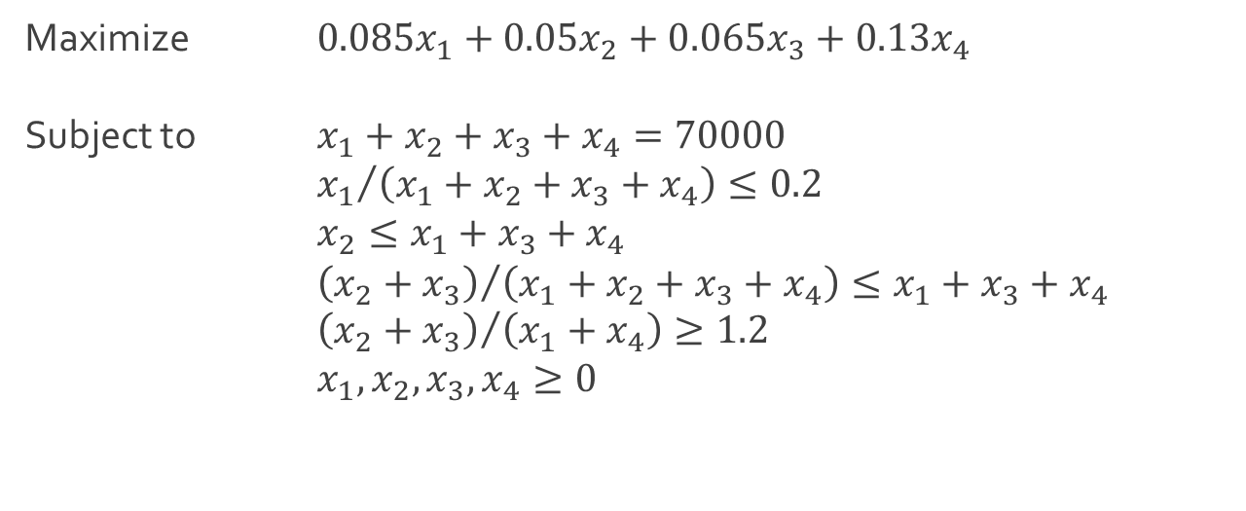
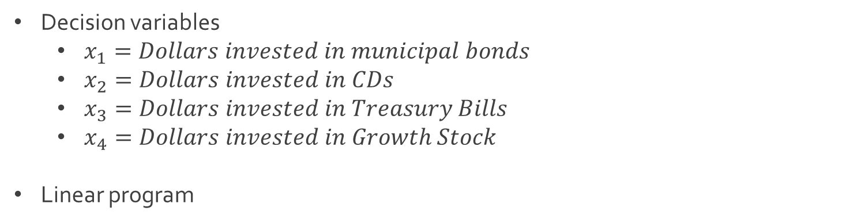
Total Integer Model
Decision variables
$x_{1}=Dollars invested in municipal bonds$
$x_{2}=Dollars invested in CDs$
$x_{3}=Dollars invested in Treasury Bills$
$x_{4}=Dollars invested in Growth Stock$
Linear program
Maximize $0.085x_{1}+0.05x_{2}+0.065x_{3}+0.13x_{4}$
Subject to $x_{1}+x_{2}+x_{3}+x_{4}=70000$
${x_{1}}/{\left(x_{1}+x_{2}+x_{3}+x_{4}\right)}≤0.2$
$x_{2}≤x_{1}+x_{3}+x_{4}$
${\left(x_{2}+x_{3}\right)}/{\left(x_{1}+x_{2}+x_{3}+x_{4}\right)}≤x_{1}+x_{3}+x_{4}$
${\left(x_{2}+x_{3}\right)}/{\left(x_{1}+x_{4}\right)}≥1.2$
$x_{1},x_{2},x_{3},x_{4}≥0$

Slide 5
0-1 Integer Model
Decision variables
$x_{1}=Dollars invested in municipal bonds$
$x_{2}=Dollars invested in CDs$
$x_{3}=Dollars invested in Treasury Bills$
$x_{4}=Dollars invested in Growth Stock$
Linear program
Maximize $0.085x_{1}+0.05x_{2}+0.065x_{3}+0.13x_{4}$
Subject to $x_{1}+x_{2}+x_{3}+x_{4}=70000$
${x_{1}}/{\left(x_{1}+x_{2}+x_{3}+x_{4}\right)}≤0.2$
$x_{2}≤x_{1}+x_{3}+x_{4}$
${\left(x_{2}+x_{3}\right)}/{\left(x_{1}+x_{2}+x_{3}+x_{4}\right)}≤x_{1}+x_{3}+x_{4}$
${\left(x_{2}+x_{3}\right)}/{\left(x_{1}+x_{4}\right)}≥1.2$
$x_{1},x_{2},x_{3},x_{4}≥0$

Slide 6
Mixed Integer Model
Decision variables
$x_{1}=Dollars invested in municipal bonds$
$x_{2}=Dollars invested in CDs$
$x_{3}=Dollars invested in Treasury Bills$
$x_{4}=Dollars invested in Growth Stock$
Linear program
Maximize $0.085x_{1}+0.05x_{2}+0.065x_{3}+0.13x_{4}$
Subject to $x_{1}+x_{2}+x_{3}+x_{4}=70000$
${x_{1}}/{\left(x_{1}+x_{2}+x_{3}+x_{4}\right)}≤0.2$
$x_{2}≤x_{1}+x_{3}+x_{4}$
${\left(x_{2}+x_{3}\right)}/{\left(x_{1}+x_{2}+x_{3}+x_{4}\right)}≤x_{1}+x_{3}+x_{4}$
${\left(x_{2}+x_{3}\right)}/{\left(x_{1}+x_{4}\right)}≥1.2$
$x_{1},x_{2},x_{3},x_{4}≥0$

Slide 7
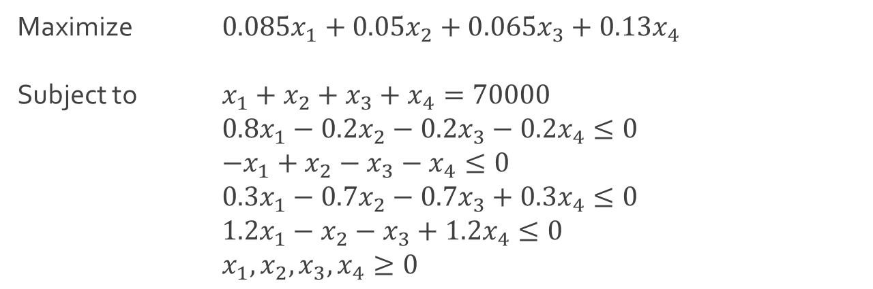

Ex: Investment
Linear program in standard form
Download Investment-1.xlsx from course website from link Sheet 1
Optimal solution $\left(x_{1},x_{2},x_{3},x_{4}\right)=(0,0,38181,3181.18)$
Maximize $0.085x_{1}+0.05x_{2}+0.065x_{3}+0.13x_{4}$
Subject to $x_{1}+x_{2}+x_{3}+x_{4}=70000$
$0.8x_{1}−0.2x_{2}−0.2x_{3}−0.2x_{4}≤0$
$−x_{1}+x_{2}−x_{3}−x_{4}≤0$
$0.3x_{1}−0.7x_{2}−0.7x_{3}+0.3x_{4}≤0$
$1.2x_{1}−x_{2}−x_{3}+1.2x_{4}≤0$
$x_{1},x_{2},x_{3},x_{4}≥0$

Slide 8
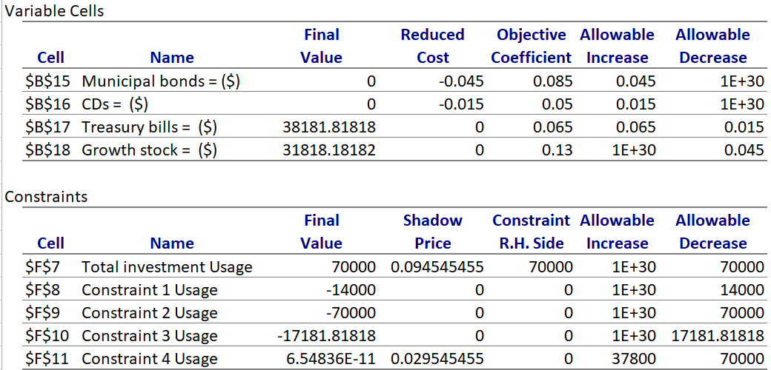
Ex: Investment
Sensitivity analysis

Slide 9
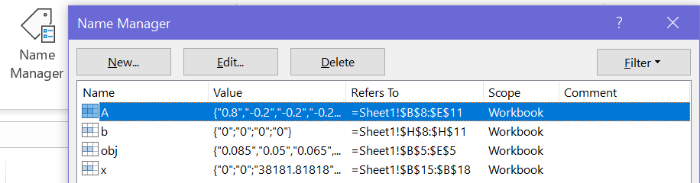
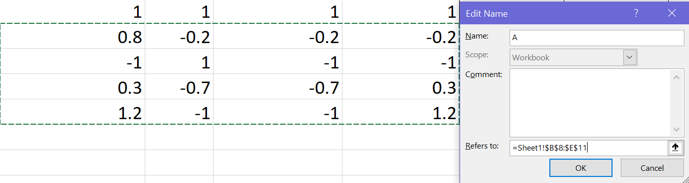
Ex: Investment
Created variables

Slide 10
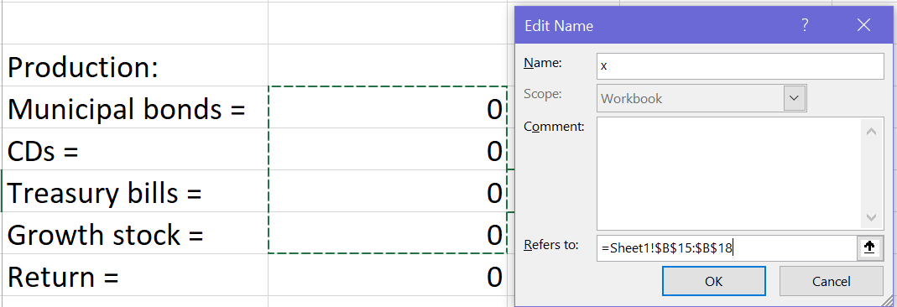
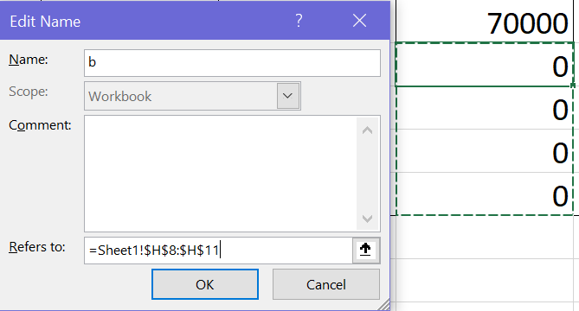
Ex: Investment
Created variables

Slide 11
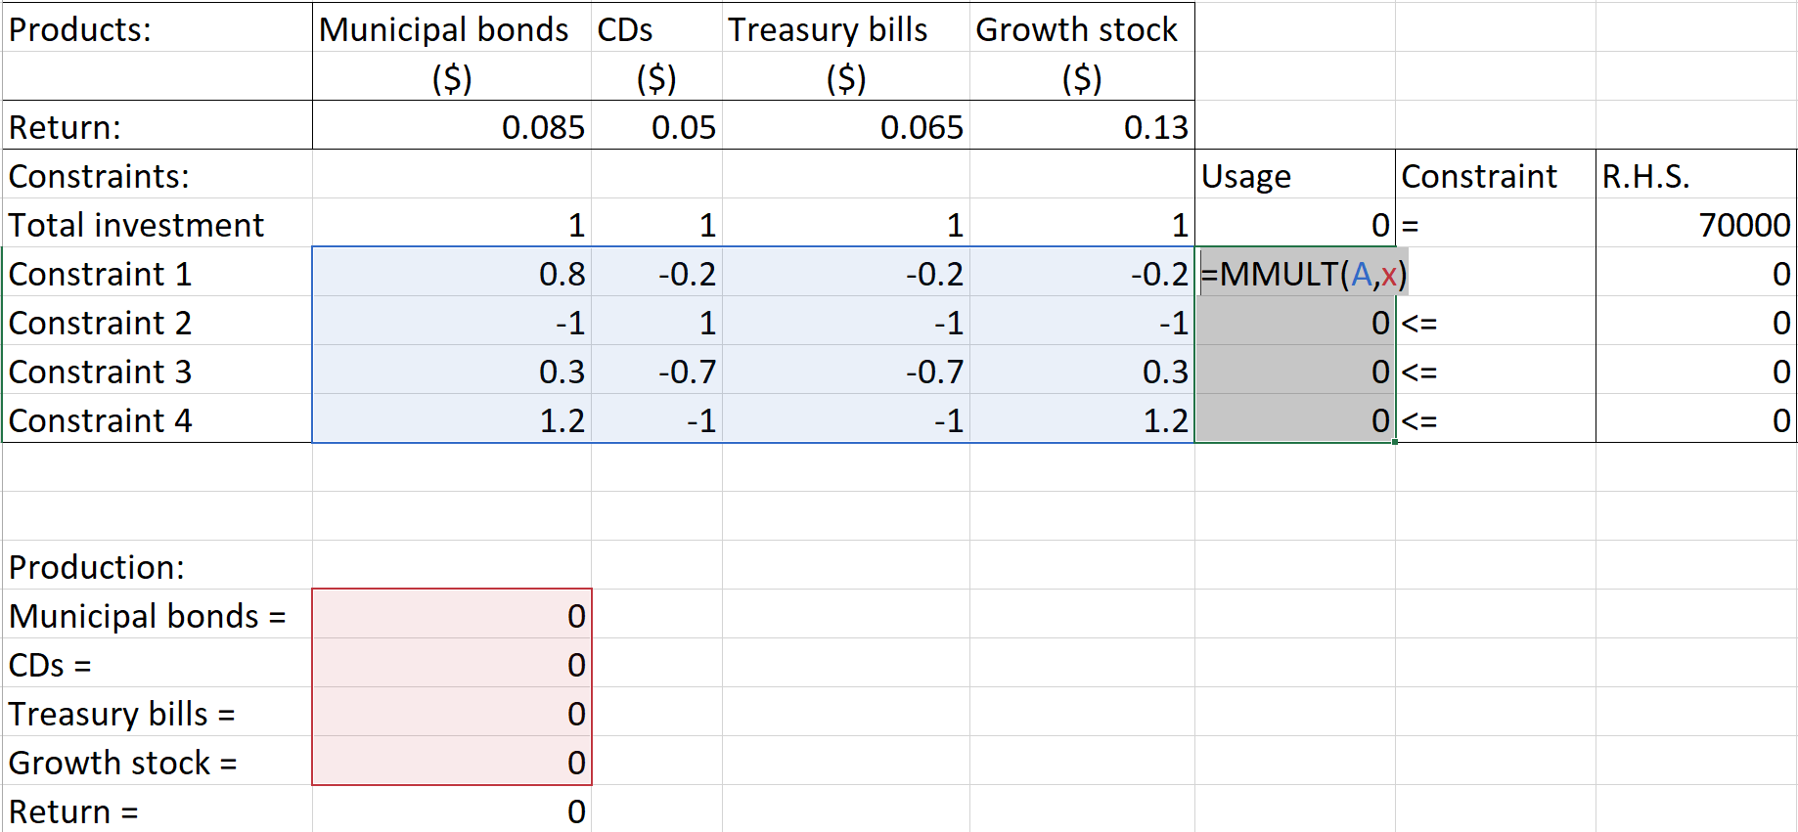
Ex: Investment
Usage of variables

Slide 12
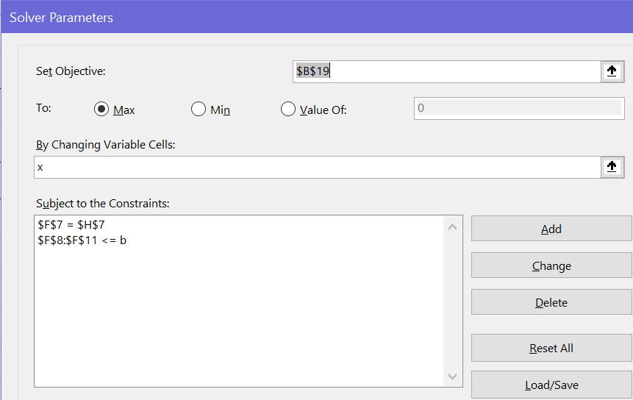
Ex: Investment
Usage of variables
Q: What other variable was created and how is it being used?

Slide 13
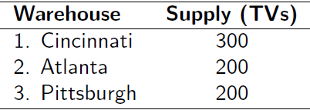
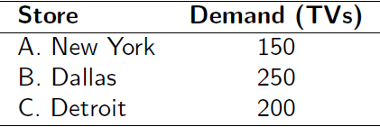
Ex: Transportation
Best Boy retail chain ships televisions from 3 of its distribution warehouses to three of its retail stores monthly
Each warehouse has a fixed supply per month and fixed demand per month
Q: How many TVs should be shipped from each warehouse to each store to minimize the total cost of transportation?
Supply (700 TVs) and Demand (600 TVs)

Slide 14
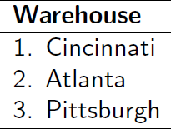
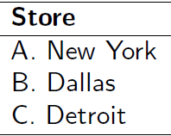
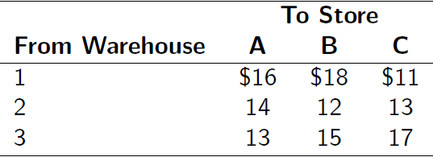
Ex: Transportation
Shipping cost per TV for each route

Slide 15
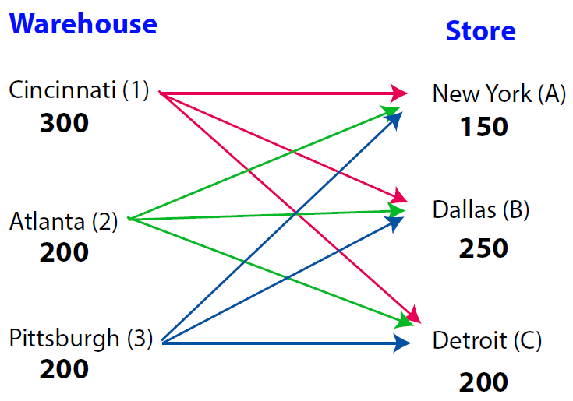
Ex: Transportation
Visual of all routes (supply > demand)

Slide 16
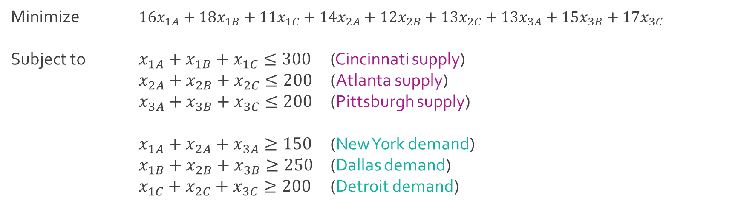
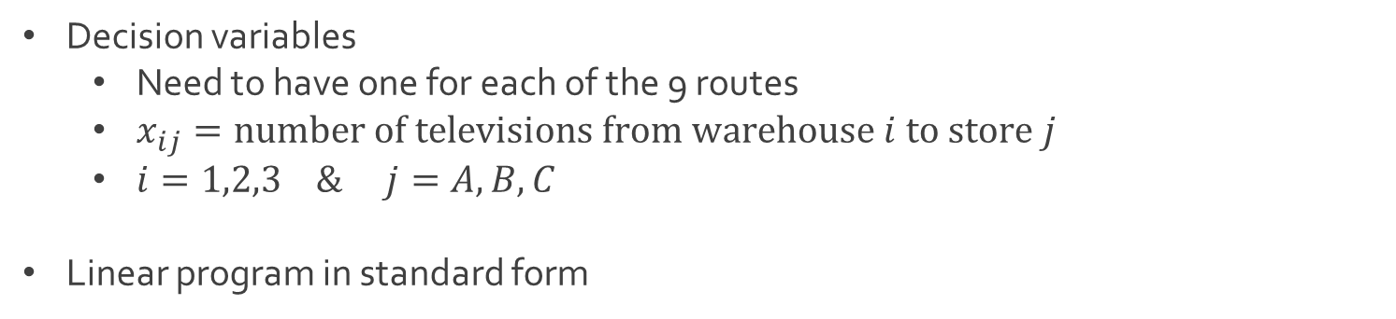
Ex: Transportation
Decision variables
Need to have one for each of the 9 routes
$x_{ij}=number of televisions from warehouse i to store j$
$i=1,2,3 \& j=A,B,C$
Linear program in standard form
Minimize $16x_{1A}+18x_{1B}+11x_{1C}+14x_{2A}+12x_{2B}+13x_{2C}+13x_{3A}+15x_{3B}+17x_{3C}$
Subject to $x_{1A}+x_{1B}+x_{1C}≤300$ (Cincinnati supply)
$x_{2A}+x_{2B}+x_{2C}≤200$ (Atlanta supply)
$x_{3A}+x_{3B}+x_{3C}≤200$ (Pittsburgh supply)
$x_{1A}+x_{2A}+x_{3A}≥150$ (New York demand)
$x_{1B}+x_{2B}+x_{3B}≥250$ (Dallas demand)
$x_{1C}+x_{2C}+x_{3C}≥200$ (Detroit demand)

Slide 17
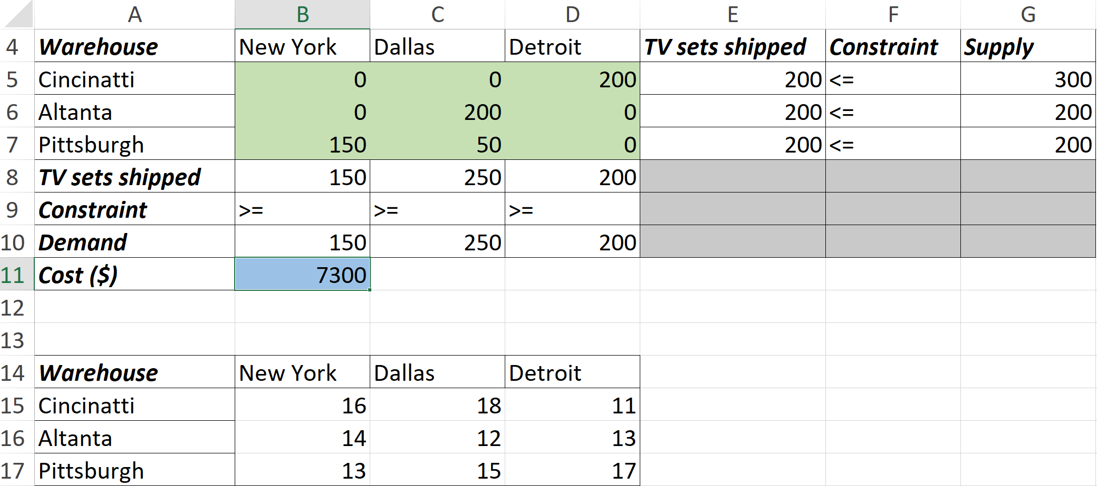
Ex: Transportation
Download Transportation-1.xlsx from course website from link Sheet 2
Sheet called Standard contains the standard linear program format and the sheet called Alternative contains a more compact form of the same linear program
Focus on Alternative sheet

Slide 18
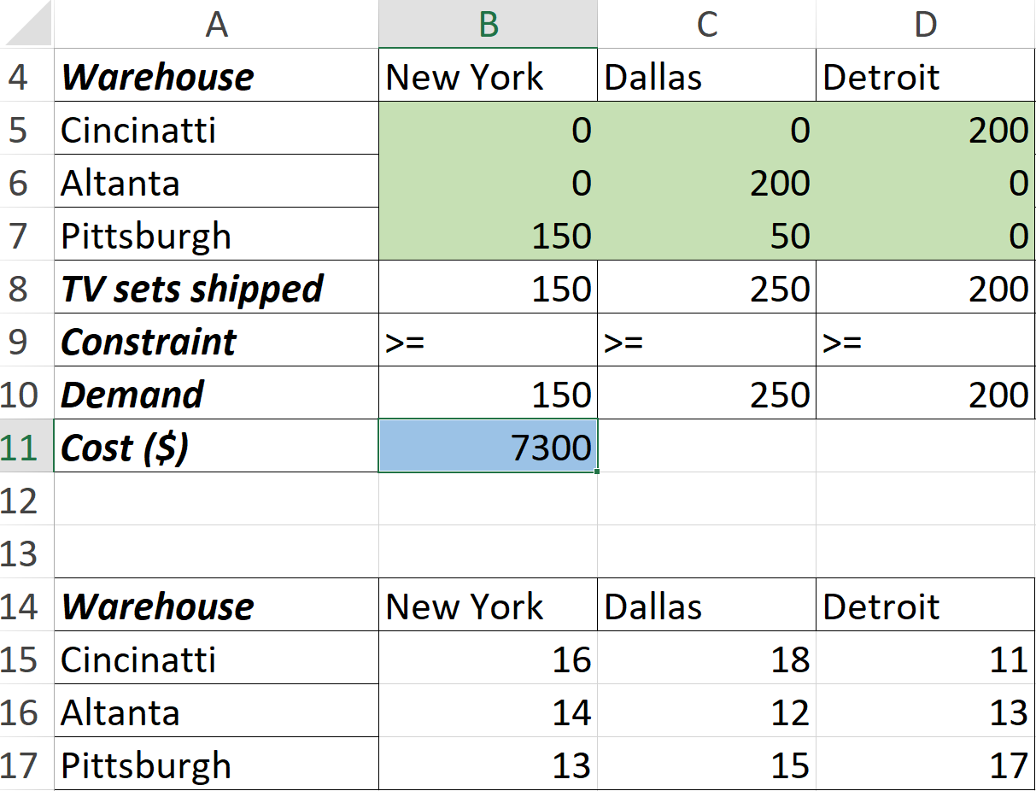
Ex: Transportation
Use of SUMPRODUCT in creation of objective function
=SUMPRODUCT(B5:D7,B15,D17)

Slide 19
Ex: Scheduling
Download Multischedule-1.xlsx from course website from link Sheet 3

Slide 23
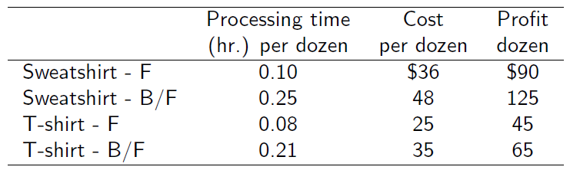
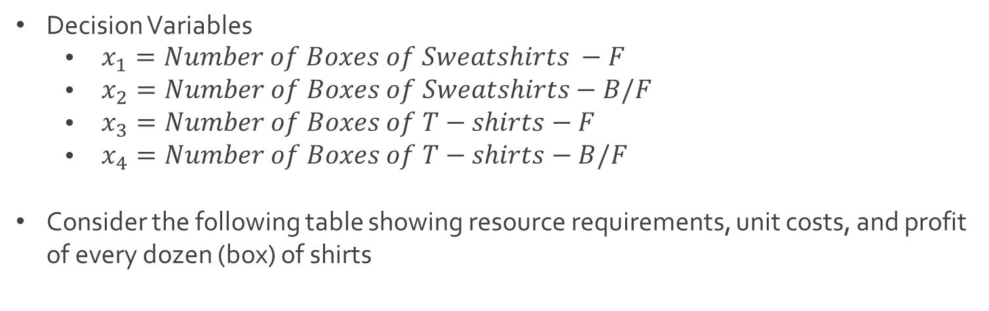
Ex: Quick-Screen Clothing
Decision Variables
$\begin{aligned} x_{1}=Number of Boxes of Sweatshirts −F\end{aligned}$
$\begin{aligned} x_{2}=Number of Boxes of Sweatshirts−\#B/F\end{aligned}$
$\begin{aligned} x_{3}=Number of Boxes of T−shirts−F\end{aligned}$
$\begin{aligned} x_{4}=Number of Boxes of T−shirts−B/F\end{aligned}$
Consider the following table showing resource requirements, unit costs, and profit of every dozen (box) of shirts

Slide 24
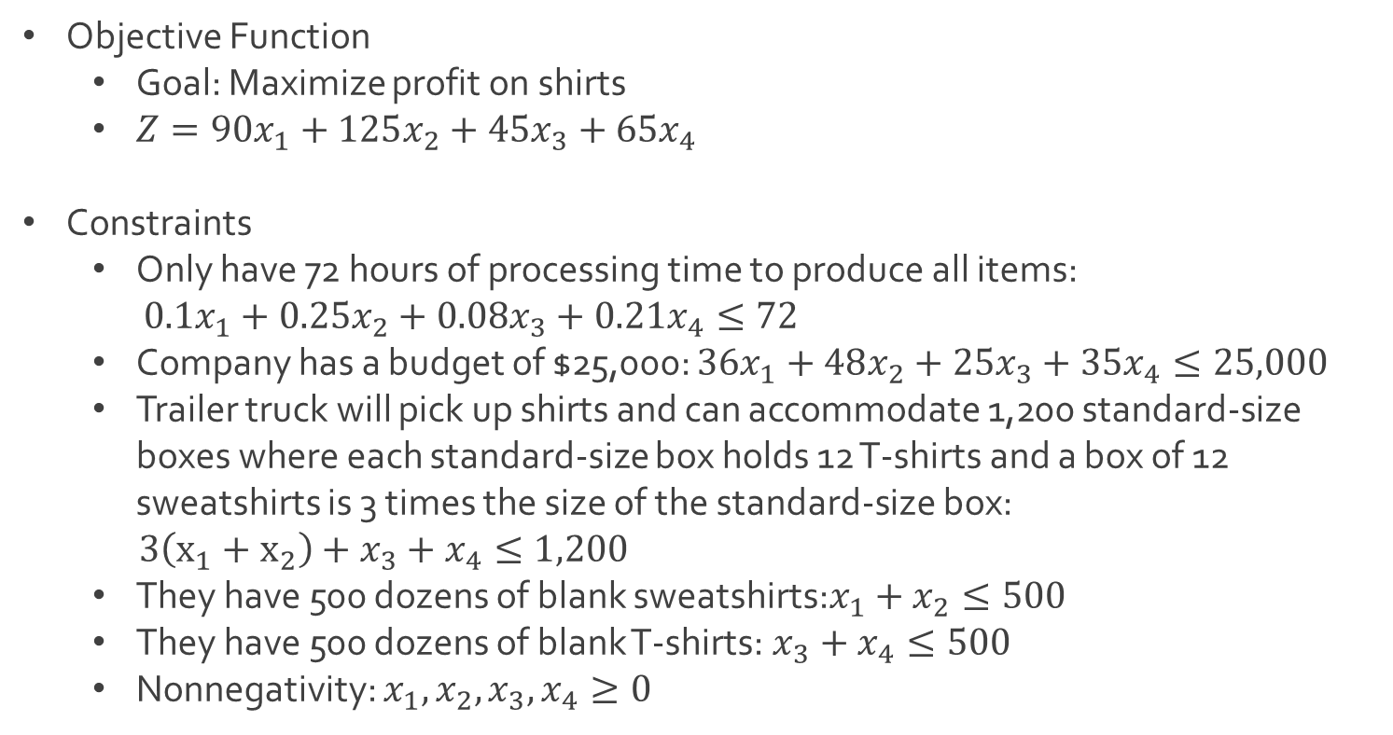
Ex: Quick-Screen Clothing
Objective Function
Goal: Maximize profit on shirts
$Z=90x_{1}+125x_{2}+45x_{3}+65x_{4}$
Constraints
Only have 72 hours of processing time to produce all items:
$0.1x_{1}+0.25x_{2}+0.08x_{3}+0.21x_{4}≤72$
Company has a budget of $25,000: $36x_{1}+48x_{2}+25x_{3}+35x_{4}≤25,000$
Trailer truck will pick up shirts and can accommodate 1,200 standard-size boxes where each standard-size box holds 12 T-shirts and a box of 12 sweatshirts is 3 times the size of the standard-size box:
$3\left(x_{1}+x_{2}\right)+x_{3}+x_{4}≤1,200$
They have 500 dozens of blank sweatshirts:$x_{1}+x_{2}≤500$
They have 500 dozens of blank T-shirts:$x_{3}+x_{4}≤500$
Nonnegativity: $x_{1},x_{2},x_{3},x_{4}≥0$

Slide 25
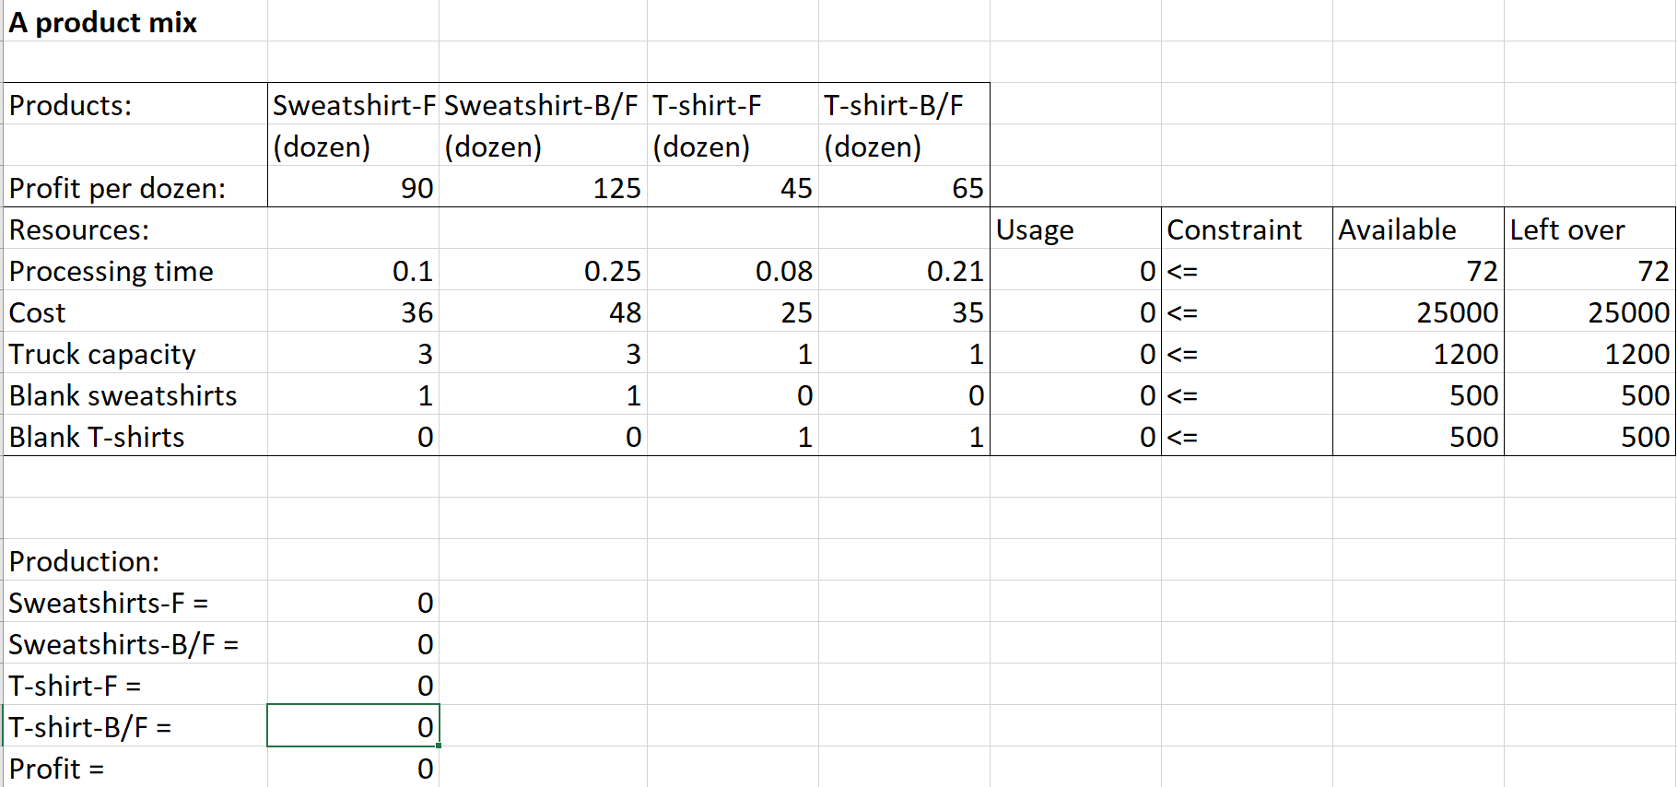
Ex: Quick-Screen Clothing
Download ProductMix.xlsx from website link called Sheet 2
Before Excel solver

Slide 26
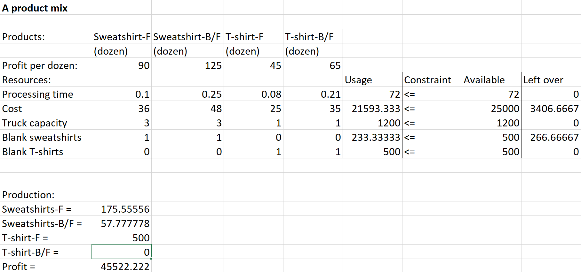
Ex: Quick-Screen Clothing
After Excel solver

Slide 27
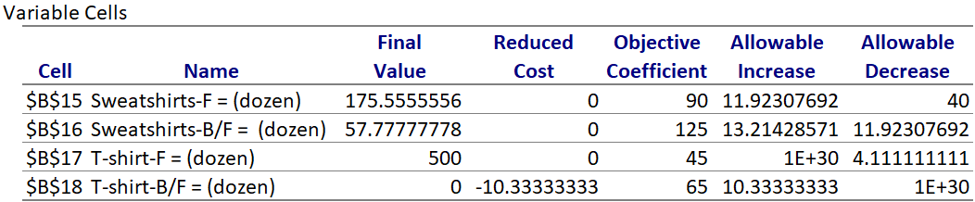
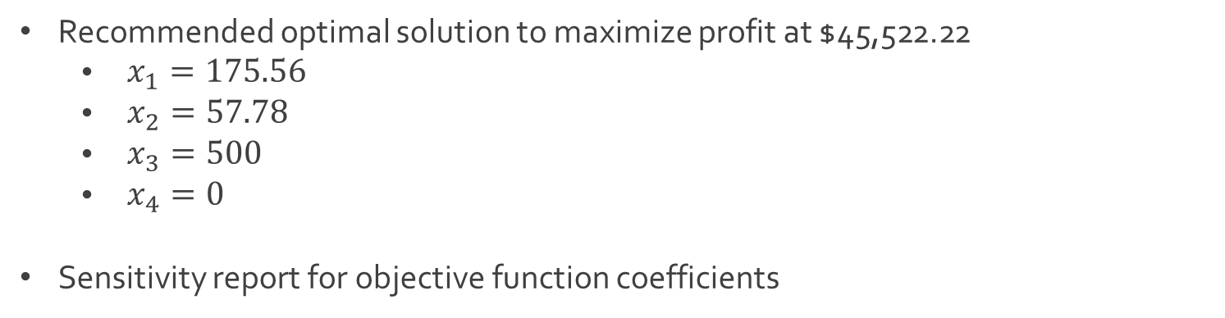
Ex: Quick-Screen Clothing
Recommended optimal solution to maximize profit at $45,522.22
$\begin{aligned} x_{1}=175.56\end{aligned}$
$\begin{aligned} x_{2}=57.78\end{aligned}$
$\begin{aligned} x_{3}=500\end{aligned}$
$\begin{aligned} x_{4}=0\end{aligned}$
Sensitivity report for objective function coefficients

Slide 28
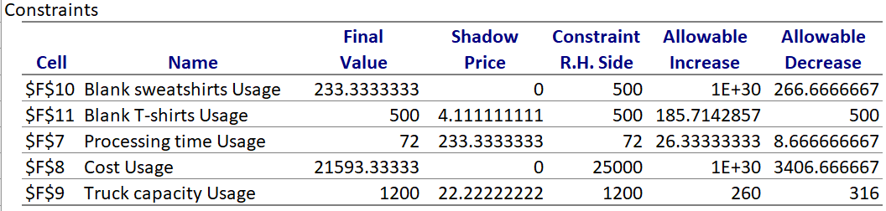
Ex: Quick-Screen Clothing
Sensitivity report for constraint quantities

Slide 29
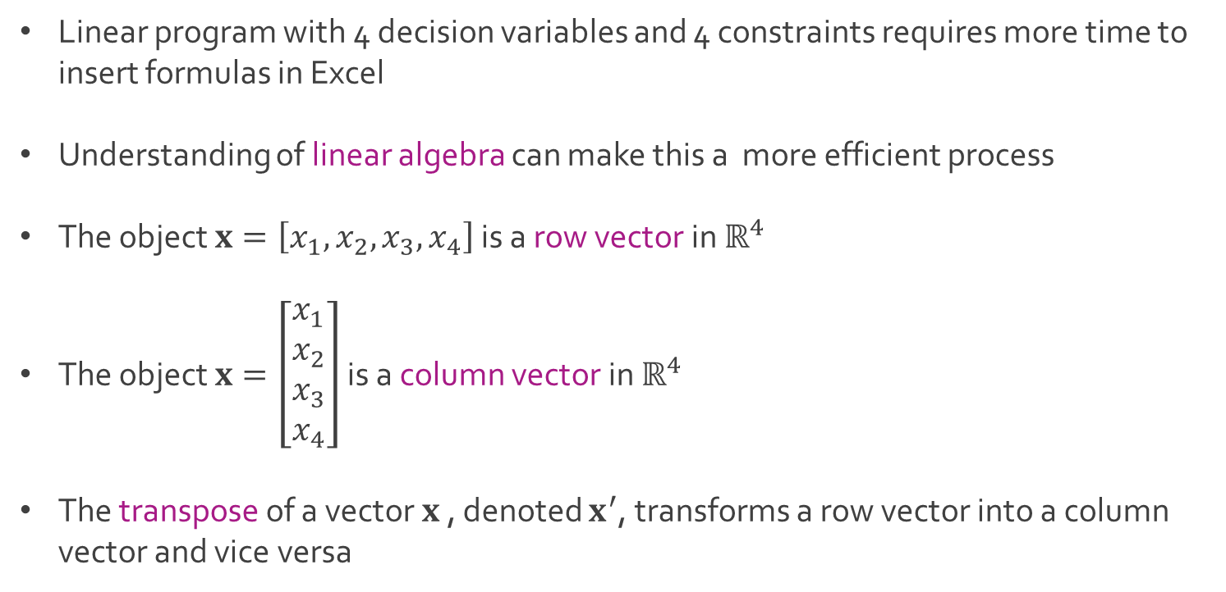
Vectors and Matrices
Linear program with 4 decision variables and 4 constraints requires more time to insert formulas in Excel
Understanding of linear algebra can make this a more efficient process
The object $x=\left[x_{1}, x_{2},x_{3},x_{4}\right]$ is a row vector in $ℝ^{4}$
The object $x=\left[\begin{matrix}x_{1} \\ x_{2} \\ x_{3} \\ x_{4}\end{matrix}\right]$ is a column vector in $ℝ^{4}$
The transpose of a vector $x$ , denoted $x^{′}$, transforms a row vector into a column vector and vice versa

Slide 30
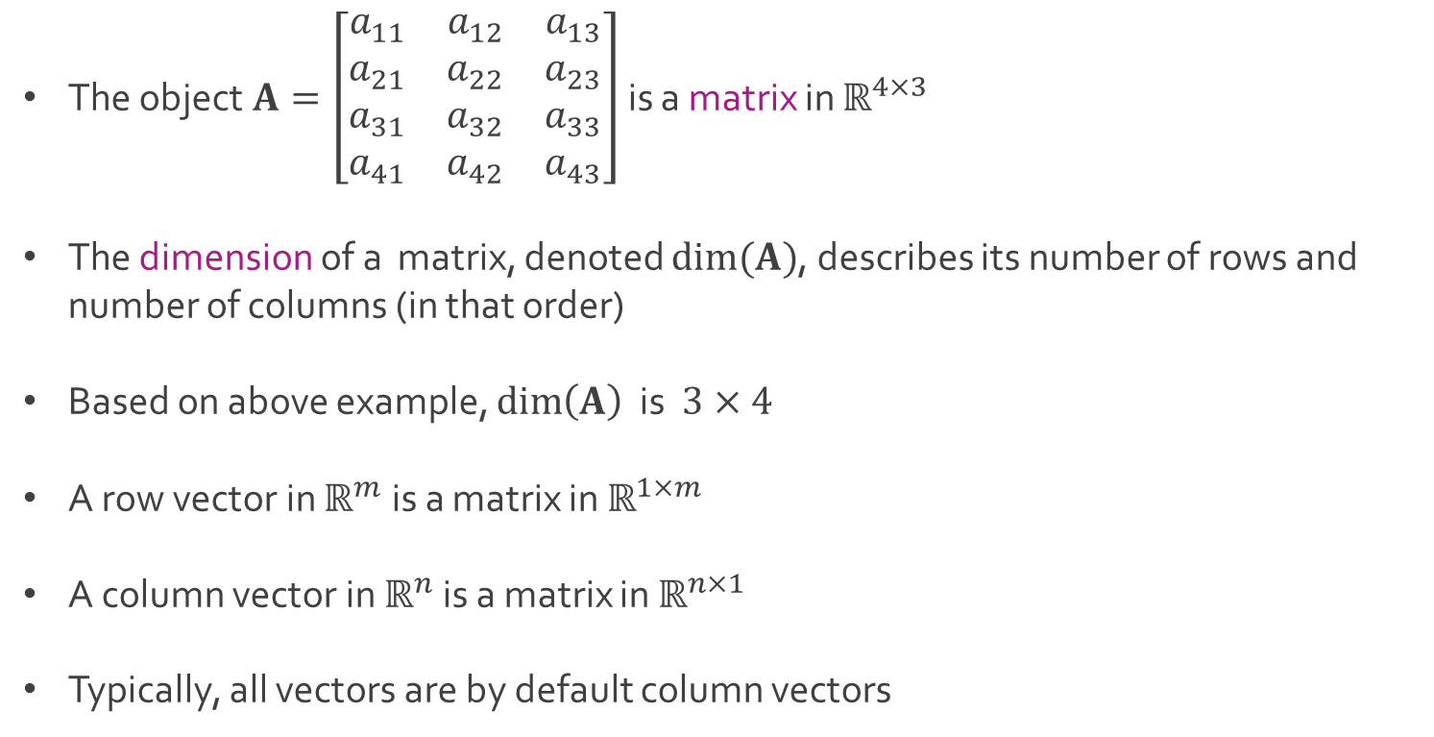
Vectors and Matrices
The object $A=\left[\begin{matrix}a_{11} & a_{12} & a_{13} \\ a_{21} & a_{22} & a_{23} \\ a_{31} & a_{32} & a_{33} \\ a_{41} & a_{42} & a_{43}\end{matrix}\right]$ is a matrix in $ℝ^{4×3}$
The dimension of a matrix, denoted $dim⁡(A)$, describes its number of rows and number of columns (in that order)
Based on above example, $\dim\left(A\right)$ is $3×4$
A row vector in $ℝ^{m}$ is a matrix in $ℝ^{1×m}$
A column vector in $ℝ^{n}$ is a matrix in $ℝ^{n×1}$
Typically, all vectors are by default column vectors

Slide 31
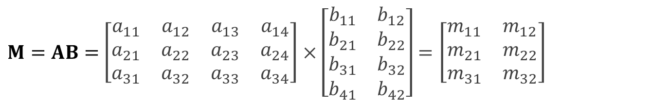

Vectors and Matrices
For matrices $A∈ℝ^{m×n}$ and $B∈ℝ^{n×p}$, we can define their product $M=AB$, which will be a matrix in $ℝ^{m×p}$
For $A∈ℝ^{3×4}$ and $B∈ℝ^{4×2}$, matrix $M=AB$ can be expressed as
where
In order to compute, $M=AB$, the number of columns in $A$ must equal the number of rows in $B$
In above example, the matrix $M=BA$ does not exist
$M=AB=$ $\left[\begin{matrix}a_{11} & a_{12} & a_{13} & a_{14} \\ a_{21} & a_{22} & a_{23} & a_{24} \\ a_{31} & a_{32} & a_{33} & a_{34}\end{matrix}\right]×\left[\begin{matrix}b_{11} & b_{12} \\ b_{21} & b_{22} \\ b_{31} & b_{32} \\ b_{41} & b_{42}\end{matrix}\right]=\left[\begin{matrix}m_{11} & m_{12} \\ m_{21} & m_{22} \\ m_{31} & m_{32}\end{matrix}\right]$
$$m_{ij}=a_{i1}b_{1j}+a_{i2}b_{2j}+a_{i3}b_{j3}+a_{i4}b_{4j} for i=1,2,3 and j=1,2$$

Slide 32
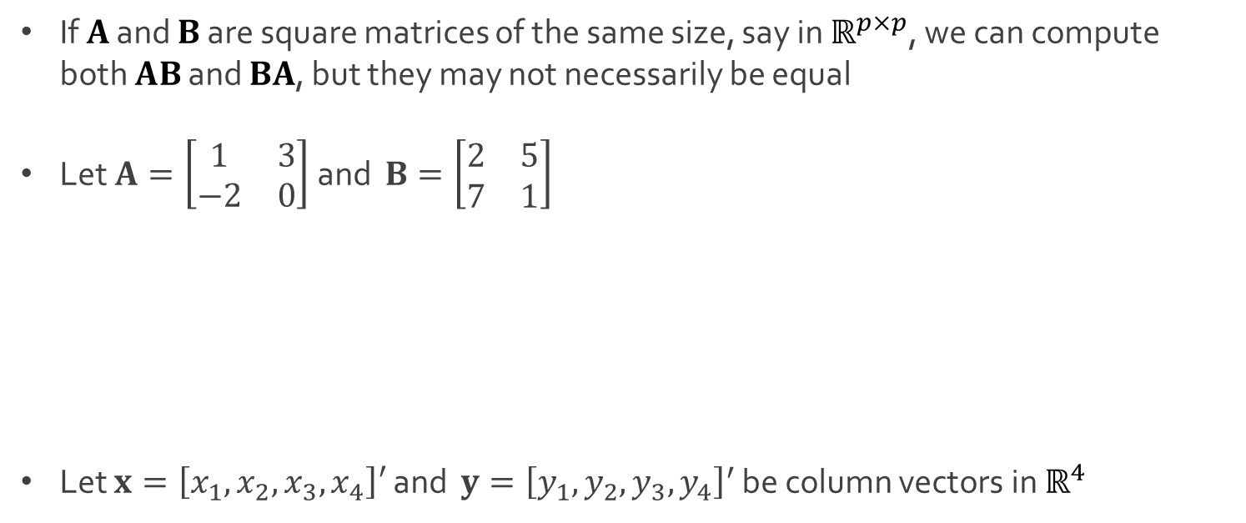
Vectors and Matrices
If $A$ and $B$ are square matrices of the same size, say in $ℝ^{p×p}$, we can compute both $AB$ and $BA$, but they may not necessarily be equal
Let $A=\left[\begin{matrix}1 & 3 \\ −2 & 0\end{matrix}\right]$ and $B=\left[\begin{matrix}2 & 5 \\ 7 & 1\end{matrix}\right]$
Let $x=\left[x_{1}, x_{2},x_{3},x_{4}\right]′$ and $y={\left[y_{1}, y_{2},y_{3},y_{4}\right]}^{′}$ be column vectors in $ℝ^{4}$
$$AB=\left[\begin{matrix}1×2+3×7 & 1×5+3×1 \\ −2×2+0×7 & −2×5+0×1\end{matrix}\right]=\left[\begin{matrix}23 & 8 \\ −4 & −10\end{matrix}\right]$$
$$BA=\left[\begin{matrix}2×1+5×−2 & 2×3+5×0 \\ 7×1+1×−2 & 7×3+1×0\end{matrix}\right]=\left[\begin{matrix}−8 & 6 \\ 5 & 21\end{matrix}\right]$$
$$x^{′}y=x_{1}y_{1}+x_{2}y_{2}+x_{3}y_{3}+x_{4}y_{4}=y^{′}x$$

Slide 33
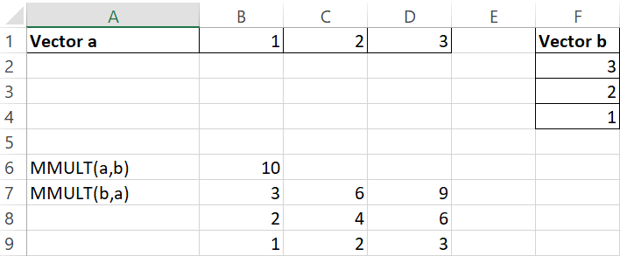
Excel: Matrix Multiplication
MMULT Function in Excel
The MMULT Function in Excel is used to multiply arrays (matrices) that have compatible dimensions and returns an array (matrix)
Syntax: MMULT(array1,array2)
Example: Vector Multiplication

Slide 34
Excel: Matrix Multiplication
MMULT Function in Excel
The MMULT function in Excel is used to multiply arrays (matrices) that have compatible dimensions and returns an array (matrix)
Syntax: MMULT(array1,array2)
Example: Vector Multiplication
=MMULT(B1:D1,F2:F4)

Slide 35
Excel: Matrix Multiplication
MMULT Function in Excel
The MMULT Function in Excel is used to multiply arrays (matrices) that have compatible dimensions and returns an array (matrix)
Syntax: MMULT(array1,array2)
Example: Vector Multiplication
=MMULT(F2:F4,
B1:D1)

Slide 36
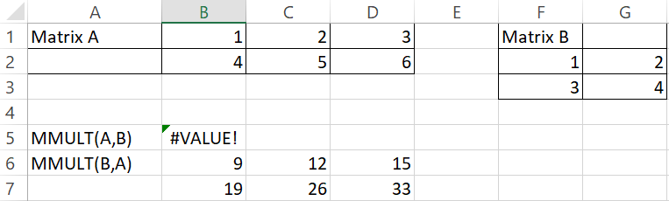
Excel: Matrix Multiplication
MMULT Function in Excel
Example: Matrix Multiplication

Slide 37
Excel: Matrix Multiplication
MMULT Function in Excel
Example: Matrix Multiplication
=MMULT(B1:D2,F2:G3)

Slide 38
Excel: Matrix Multiplication
MMULT Function in Excel
Example: Matrix Multiplication
=MMULT(F2:G3,B1:D2)

Slide 39
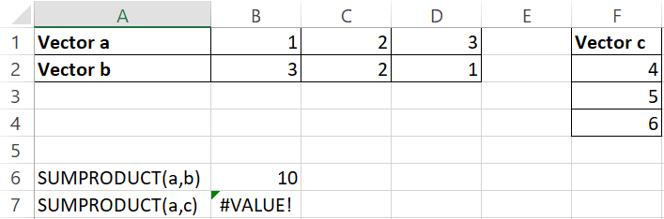
Excel: Matrix Multiplication
SUMPRODUCT Function in Excel
The SUMPRODUCT function in Excel is used to multiply arrays (matrices) element-wise and then returns the sum of their products
In mathematics, this is often referred to as a cross-product or vector-product when the arrays are vectors
Syntax: SUMPRODUCT(array1,array2)
Ex: Cross-product

Slide 40
Excel: Matrix Multiplication
SUMPRODUCT Function in Excel
The SUMPRODUCT function in Excel is used to multiply arrays (matrices) element-wise and then returns the sum of their products
In mathematics, this is often referred to as a cross-product or vector-product when the arrays are vectors
Syntax: SUMPRODUCT(array1,array2)
Ex: Cross-product
=SUMPRODUCT(B1:D1,B2:D2)

Slide 41
Excel: Matrix Multiplication
SUMPRODUCT Function in Excel
The SUMPRODUCT function in Excel is used to multiply arrays (matrices) element-wise and then returns the sum of their products
In mathematics, this is often referred to as a cross-product or vector-product when the arrays are vectors
Syntax: SUMPRODUCT(array1,array2)
Ex: Cross-product
=SUMPRODUCT(B1:D1,F2:F4)

Slide 42
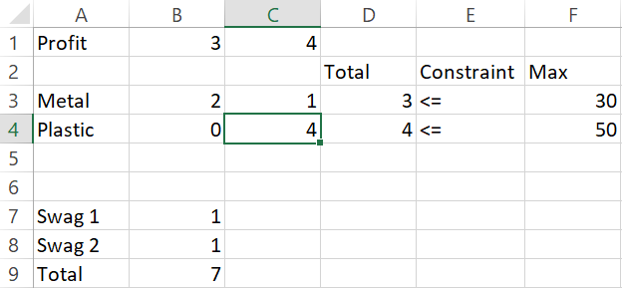
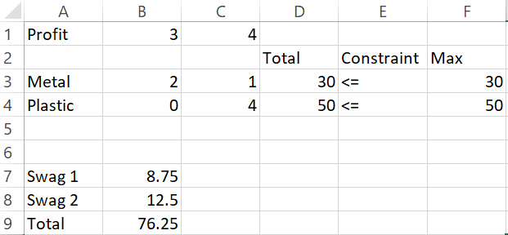
Excel: Application of Matrices
Both MMULT and CROSSPRODUCT can be used in Excel to make the creation of formulas and constraints of linear programs considerably easier
Made up example for practice
Solver

Slide 43
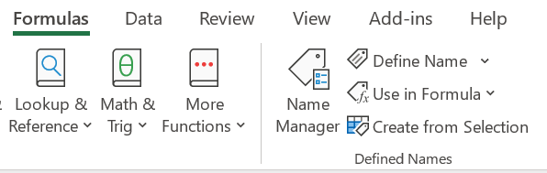
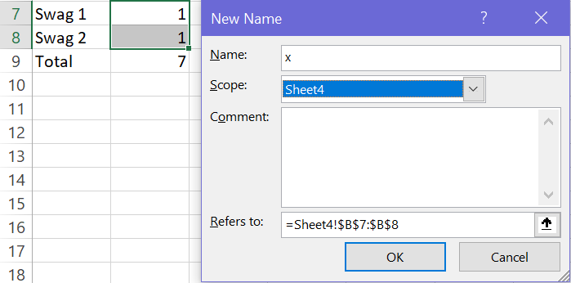
Excel: Application of Matrices
Creating EXCEL variable for easy referencing

Slide 44
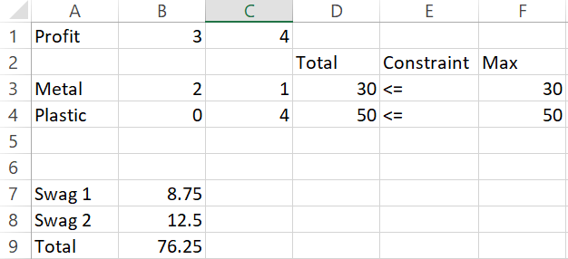
Excel: Application of Matrices
Usage of created variable in establishing constraints and objective function
=MMULT(B4:C4,x)
=MMULT(B1:C1,x)

Slide 45
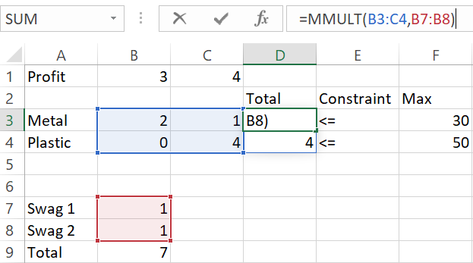
Excel: Application of Matrices
Another option for specification

Slide 46
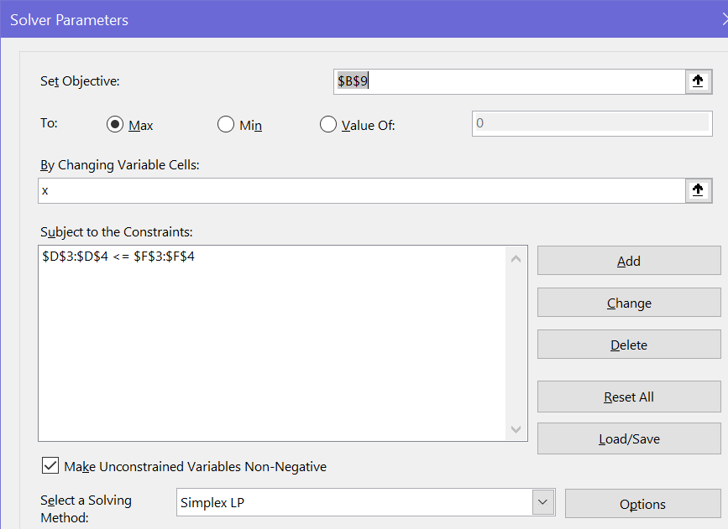
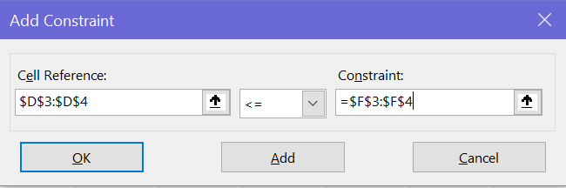
Excel: Application of Matrices
Another option for specification

Slide 47
Excel: Application of Matrices
Try using MMULT and SUMPRODUCT in cell formulas
Try using vectors/matrices in specification of constraints
Download Lecture6WS.xlsx from course website from link Sheet 2 for all examples seen in this lecture

Slide 48




The End
Dale

